Slide 1
The list of learning goals

Slide 2






The learning goal of the n^{th} stage
|$f\left(x^{c},w\right)$- y^{c}| ≤ ε ∀ c ∈$I(n)$
regression problems
|e^{c}| $≤\text{ε}$ ∀ c ∈$I(n)$
$$f\left(x^{c},w\right)$$
y^{c} - ε
y^{c} + ε
y^{c}
The inferencing goal
$$unacceptable$$
The regression inferencing module
$$f\left(x^{c},w\right)$$
y^{c} - ε
y^{c} + ε
$$acceptable$$

Slide 3

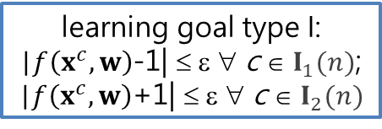

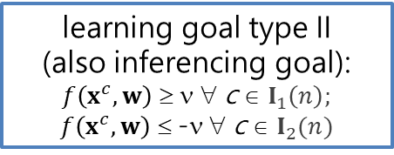
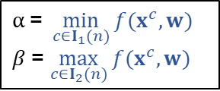



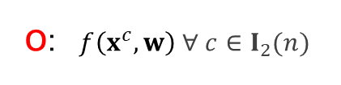



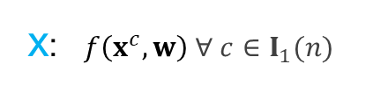
The learning goal of the n^{th} stage
y^{c} = 1 $∀ c∈I_{1}$(n); y^{c} = -1 $∀ c∈I_{2}$(n);$I$(n) ≡ $I_{1}$(n) ∪ $I_{2}$(n)
classification problems
x: $f\left(x^{c},w\right) ∀ c∈I_{1}(n)$
learning goal type I:
|$f\left(x^{c},w\right)$-1| ≤ ε ∀ c ∈ $I_{1}(n)$;
|$f\left(x^{c},w\right)$+1| ≤ ε ∀ c ∈ $I_{2}(n)$
o: $f\left(x^{c},w\right) ∀ c∈I_{2}(n)$
$$−1$$
1
o
o
o
x
o
x
x
x
$$f\left(x^{c},w\right)$$
|e^{c}| $≤\text{ε}$ ∀ c ∈$I(n)$
Undecided
ε Is a hyper-parameter regarding the learning!
$$−v$$
$$v$$
learning goal type II
(also inferencing goal):
$f\left(x^{c},w\right)$ ≥ ν ∀ c ∈ $I_{1}\left(n\right);$ $f\left(x^{c},w\right)$ ≤ -ν ∀ c ∈ $I_{2}(n)$
The classification inferencing module
o
o
o
o
x
x
x
x
$$f\left(x^{c},w\right)$$
Undecided
ν Is a hyper-parameter regarding the inferencing!
$$β$$
$$α$$
$$α \text{=} \min_{c∈I_{1}(n)}{f(x^{c},w)}$$
$β$= $\max_{c∈I_{2}(n)}{f(x^{c},w)}$
learning goal type III: SeC
o
o
o
x
x
o
x
x
$$f\left(x^{c},w\right)$$

Slide 4


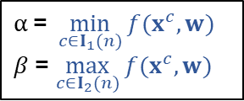

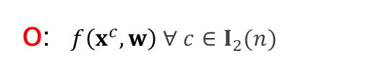


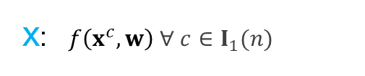


The acceptance is based on the learning goal
Acceptance is applied to not only the SLFN but also each individual training data.
y^{c} = 1 $∀ c∈I_{1}$(n); y^{c} = -1 $∀ c∈I_{2}$(n);$I$(n) ≡ $I_{1}$(n) ∪ $I_{2}$(n)
x: $f\left(x^{c},w\right) ∀ c∈I_{1}(n)$
$$α \text{=} \min_{c∈I_{1}(n)}{f(x^{c},w)}$$
$β$= $\max_{c∈I_{2}(n)}{f(x^{c},w)}$
$$α$$
$$β$$
o: $f\left(x^{c},w\right) ∀ c∈I_{2}(n)$
o
o
x
o
x
o
x
x
$$β$$
$$α$$
$$f\left(x^{c},w\right)$$
$$α$$
$$β$$
o
o
o
x
x
o
x
x
$$f\left(x^{c},w\right)$$
o
o
o
x
x
o
x
x
$$f\left(x^{c},w\right)$$
SeC: True
SeC: False

